Slide 1
Slides for ECI website in Region 11

Slide 2
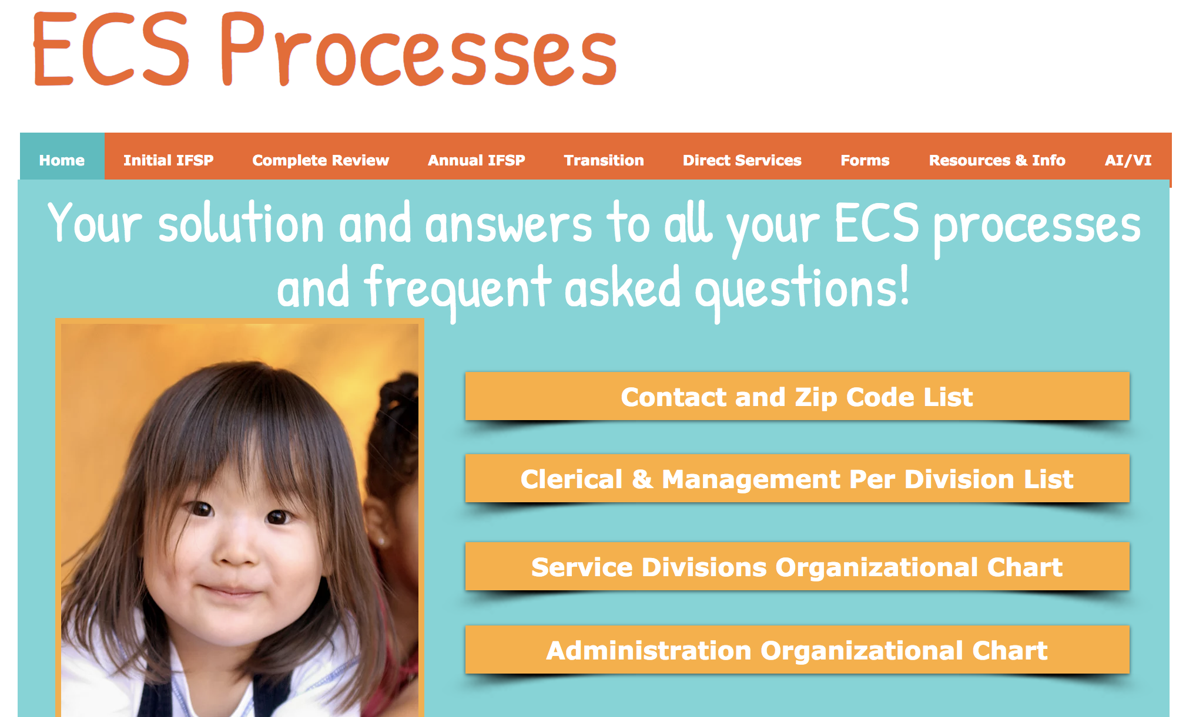
After eligibility determination, if DHH/VI teachers
are not present...
There is a concern for a ECI client’s hearing and/or vision but no medical documentation providing a diagnosis. If caregivers are hesitant about moving forward and/or need further assistance or education ECI can get ROI for the LEA and fill out the DHH/VI Consultation Form found on the ECI Processes website.

Slide 3
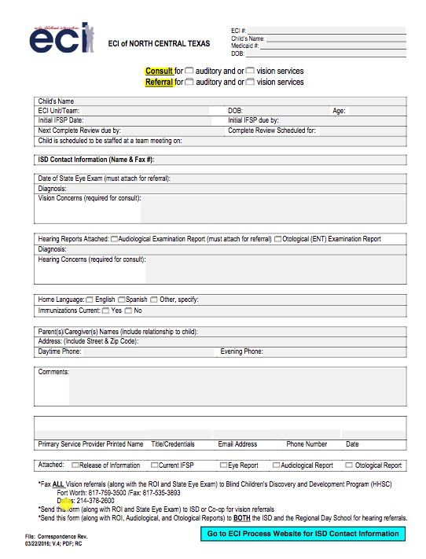
DHH/VI Referral Form
Click here to access the form on the website

